Slide 1
Savitzky-golay smoothing filter
B649 DataFlow SuperComputing: Assignment 2

Slide 2
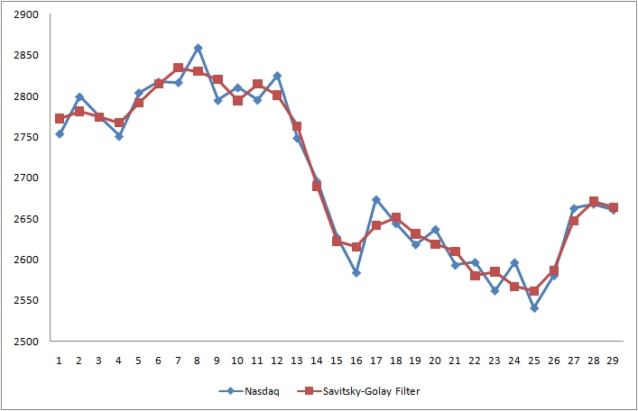
Introduction
A Savitzky–Golay filter is a digital filter
it can be applied to a set of digital data points for the purpose of smoothing the data
to increase the signal-to-noise ratio without greatly distorting the signal.

Slide 3
Advantages of the filter
The Savitzky-Golay filter removes high frequency noise from data.
It has the advantage of preserving the original shape
and features of the signal better than other types of filtering approaches
such as moving averages techniques.

Slide 4
Properties of the filter
The Savitzky-Golay is a type of low-pass filter
particularly suited for smoothing noisy data
The main idea behind this approach is to make for each point
a least-square fit with a polynomial of high order over a odd-sized window
centered at the point.

Slide 5


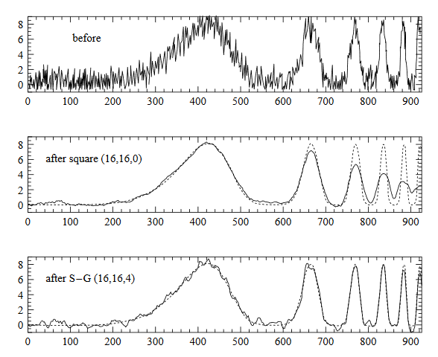
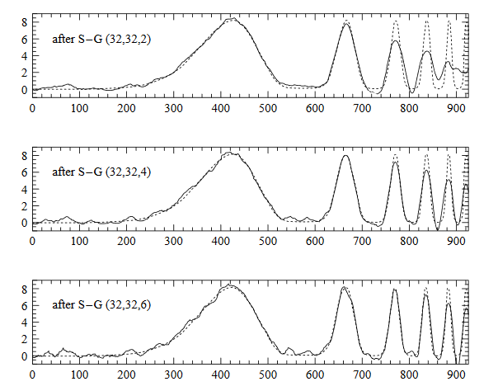
Example

Slide 6
Extracting Kernels
We need to identify key loops in the algorithm
That can be transformed into Maxeler kernels
The c language implementation of Savitzky Golay smoothing filter has 47 loops
of which 22 are nested
So extraction of key loops was challenging

Slide 7
Extracted Kernel
I was able to identify a loop that was repeated 4 times inside the nested loops
The loop was used to find the normal distance between elements of the matrix
Following is the original code of the loop:

Slide 8
Maxeler Kernel for the extracted loop

Slide 9
Kernel Manager

Slide 10
Kernel GRaph

Slide 11
Conclusion

